Slide 1



Slide 2



敲敲门
你在不在？

Slide 3
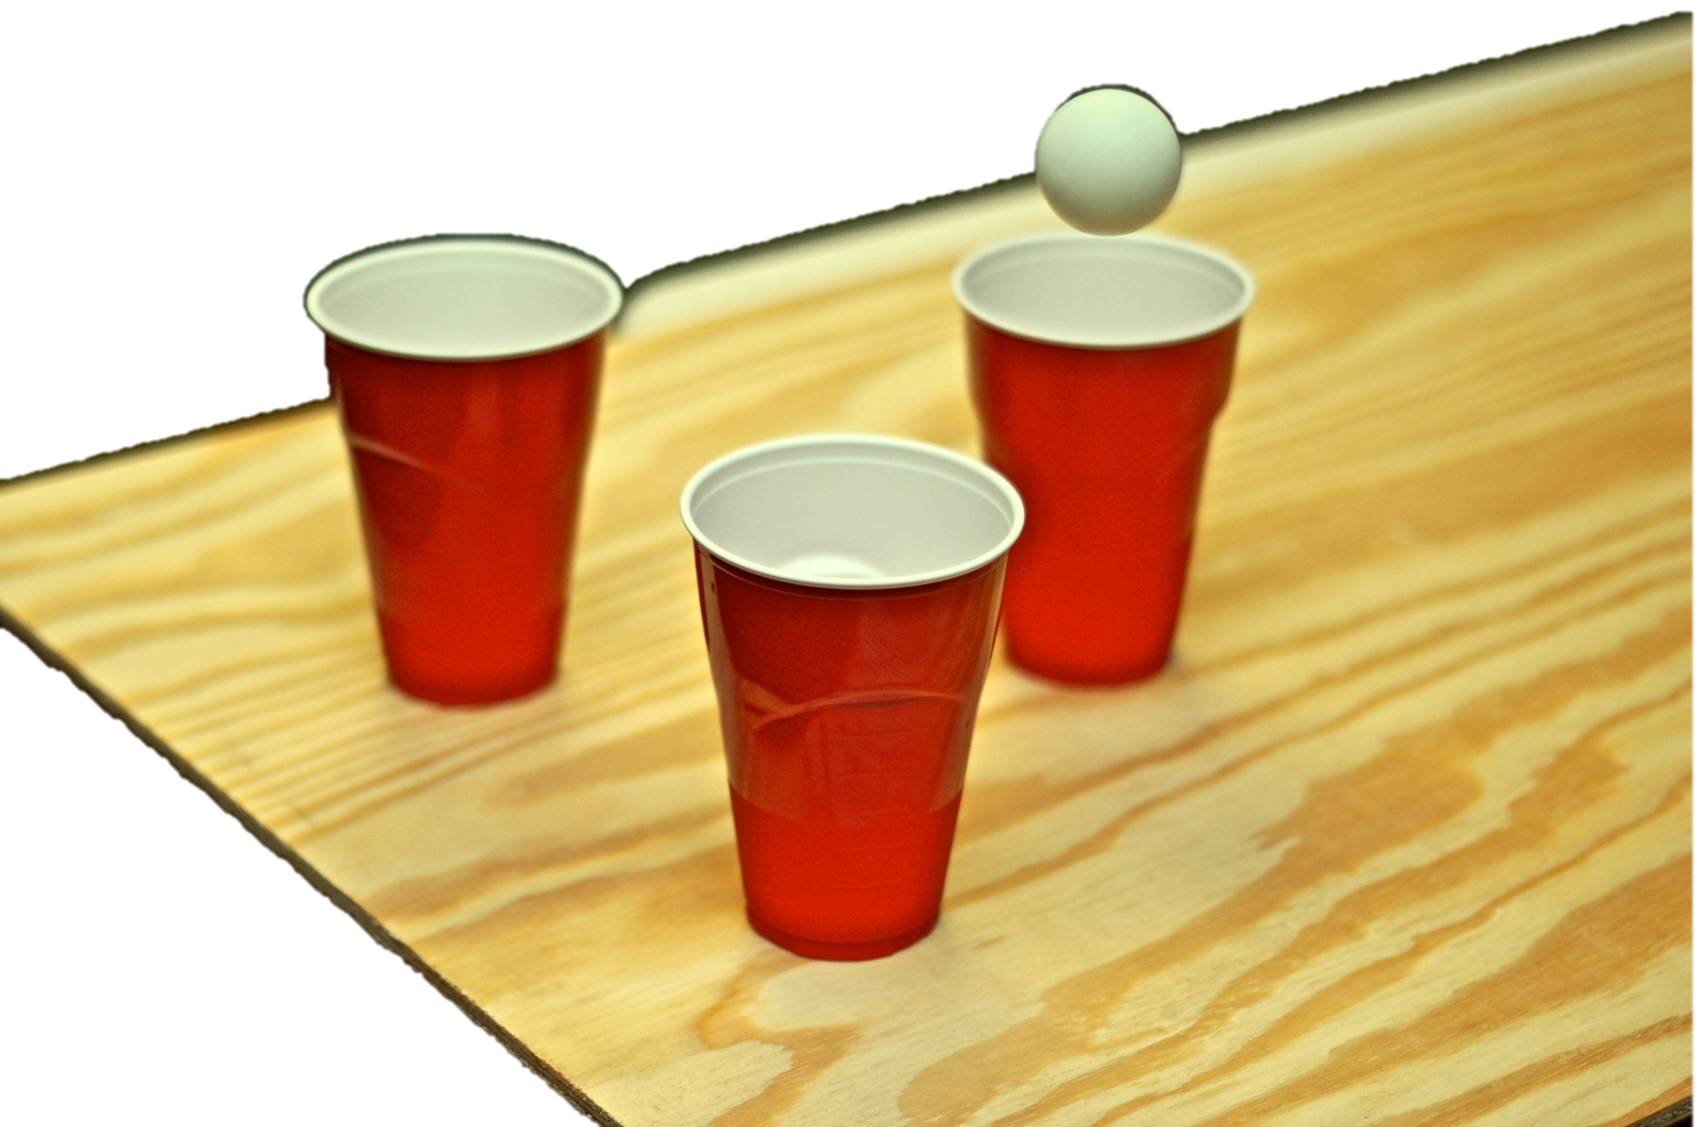
敲敲乒乓球
拿一粒球
把球丢进杯里面
在进杯子之前，球必须先
打在桌面上

Slide 4
开心欢唱

Slide 5

看见神的爱

Slide 6
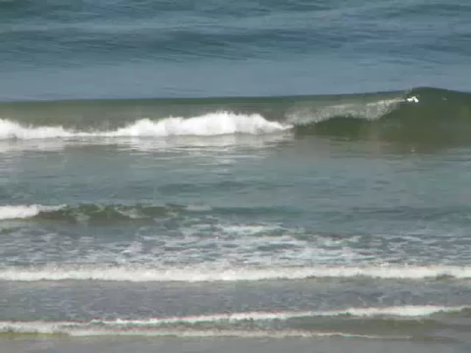
Notes:
Sing Sister Act’s “I will follow Him” and Josh Groban’s “You Raise me up” or other appropriate songs

Slide 7
故事 1
Notes:
Pre-arrange a testimony of how your member met the Lord and realized His greatness, power and love, and how he turned from idolatry/other gods to follow the Lord, and the difference/blessings to his life after becoming a Christian

Slide 8
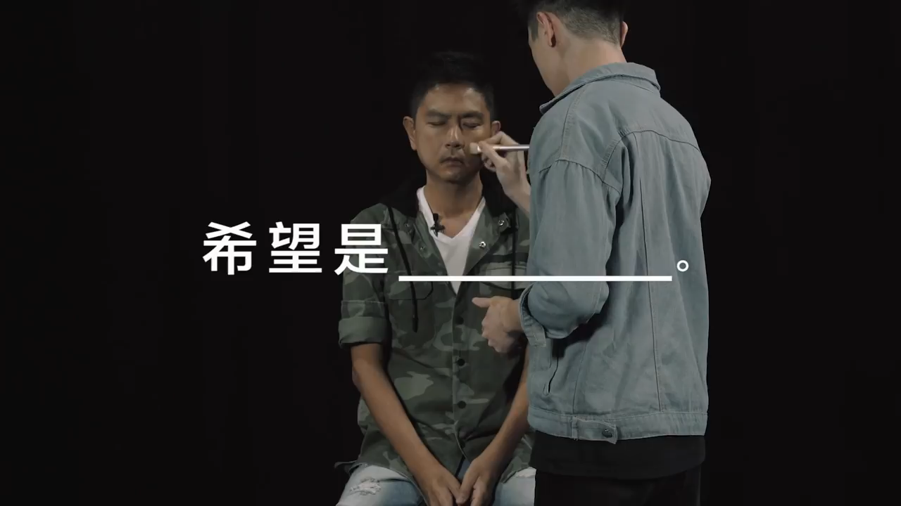
周初明的故事

Slide 9

“天父一封爱的来信”

Slide 10
祂在敲门
正在敲你的心门
盼望你会来开门
一个小朋友和他爸爸散步时经过一间教堂。
他们看见一幅真人大小的“耶稣在敲门”的
画像。孩子仔细研究了这幅画一分钟左右，
然后对他爸爸说：“爸，是谁在敲门呢？”
父亲回答：“孩子，是耶稣。”
Notes:
Jesus has come for the relationship. He does not force His way in, or arrive in order to condemn us; rather, Jesus knocks on the door of our heart in order to present a gift – the gift of Himself so that through Him, we may become children of God. Jesus wants “full access” to our heart, not some of it, not most of it, He wants access to all of our heart. He wants to be our LORD...and our KING...and our VERY BEST FRIEND. But how much access He has to your heart and mine is entirely dependent upon us.

Slide 11
祂在敲门
正在敲你的心门
盼望你会来开门
孩子说：“那么，谁在里面呢？”
父亲回答：“孩子，任何人都有可能！
可能是你，或者也可能是我。”
孩子沉默了一会儿，然后，轻轻地对父亲
说：“爸！如果是我，我会让耶稣进来。”
Notes:
Jesus is knocking on the door of your heart today. What is your response to Him?

Slide 12

祂在你心门外敲门、敲门
你愿意让祂进来吗？
Notes:
Jesus is knocking on the door of your heart today. What is your response to Him?

Slide 13
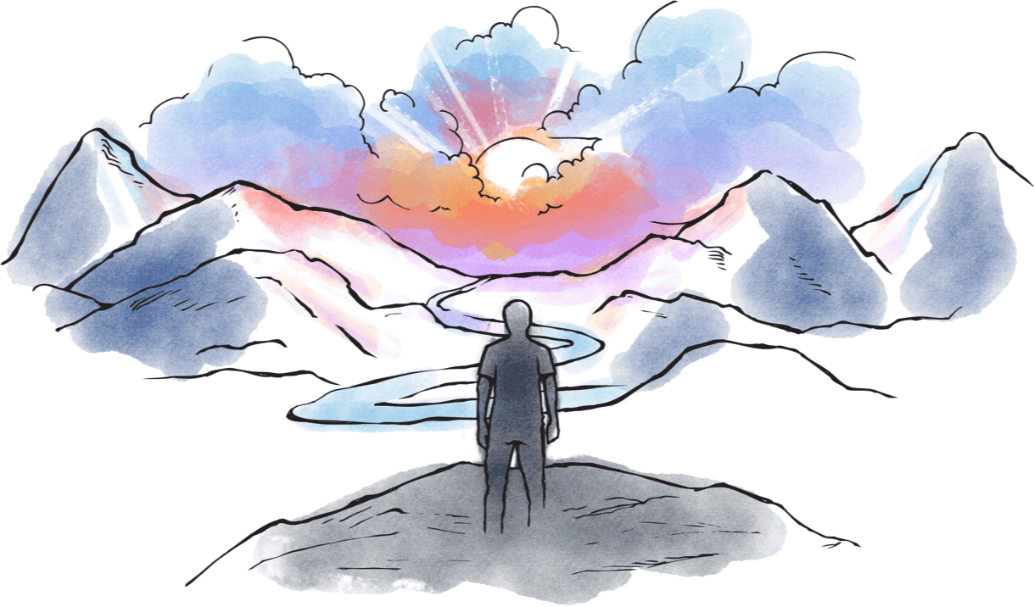
约翰福音1:12
“凡接纳他的，就是信他名的人，他就
赐他们权柄作神的儿女。”

Slide 14
在十字架上，
耶稣为你的罪付出赎价

Slide 15
只有耶稣能够填满
我们生命中“神形状”的真空

Slide 16
祂在不停的敲门、敲门
祂要进入你的生命

Slide 17
祂曾敲过你的心门，
现在祂仍在敲你的心门！
即使你曾因祂把门关上！

Slide 18
你只需要打开心门
让他进去，你便能享受神儿女的权利

Slide 19
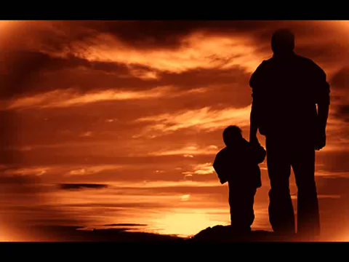
So You Would Come
Notes:
Playback YouTube video “So You Would Come”

Slide 20
祂就站在那里……
等你开门！

Slide 21
你是否愿意打开你的心门？ 和我们一起祷告吧！
Notes:
Lead everyone in saying the Sinner’s Prayer to invite Jesus into their lives

Slide 22
敲门！
敲敲门！
我们可以怎样为你祷告？
敲敲门
你在不在？

Slide 23
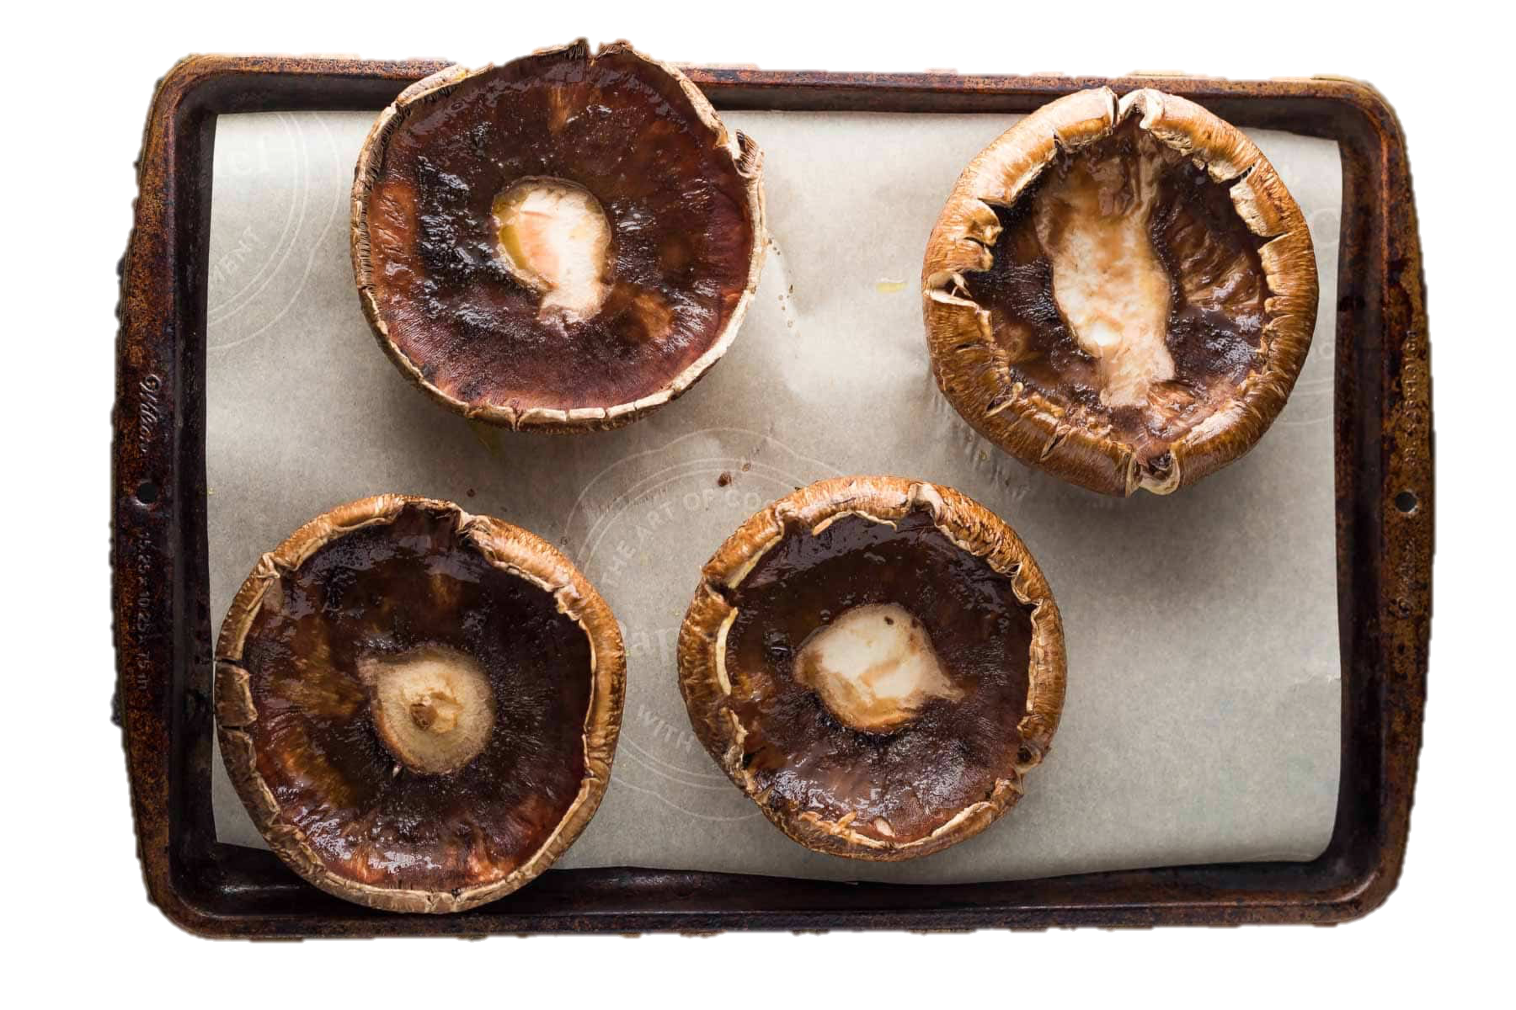
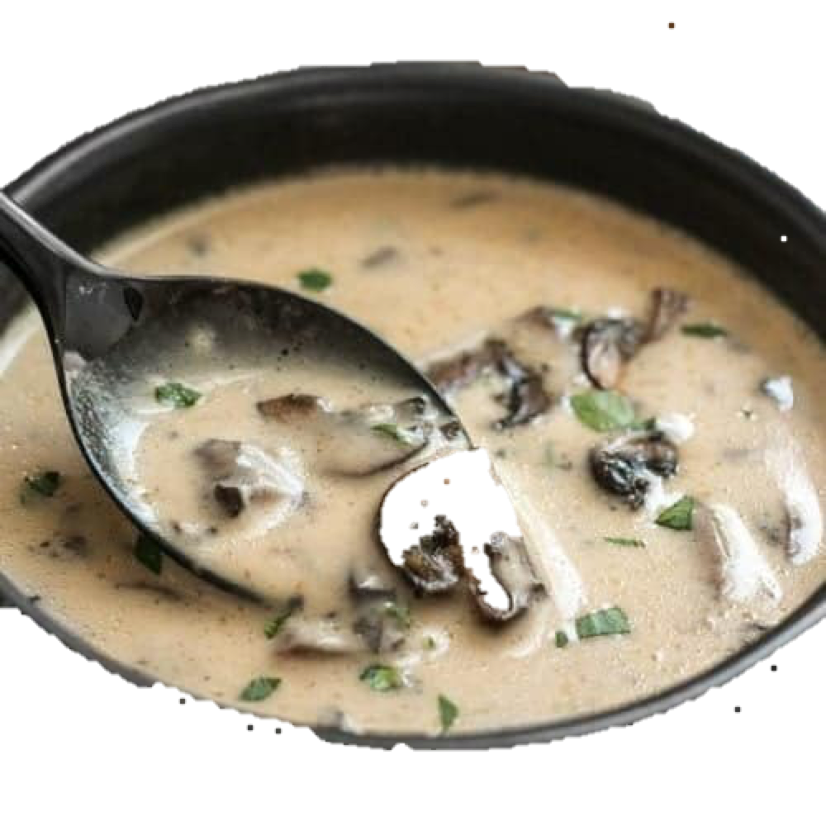
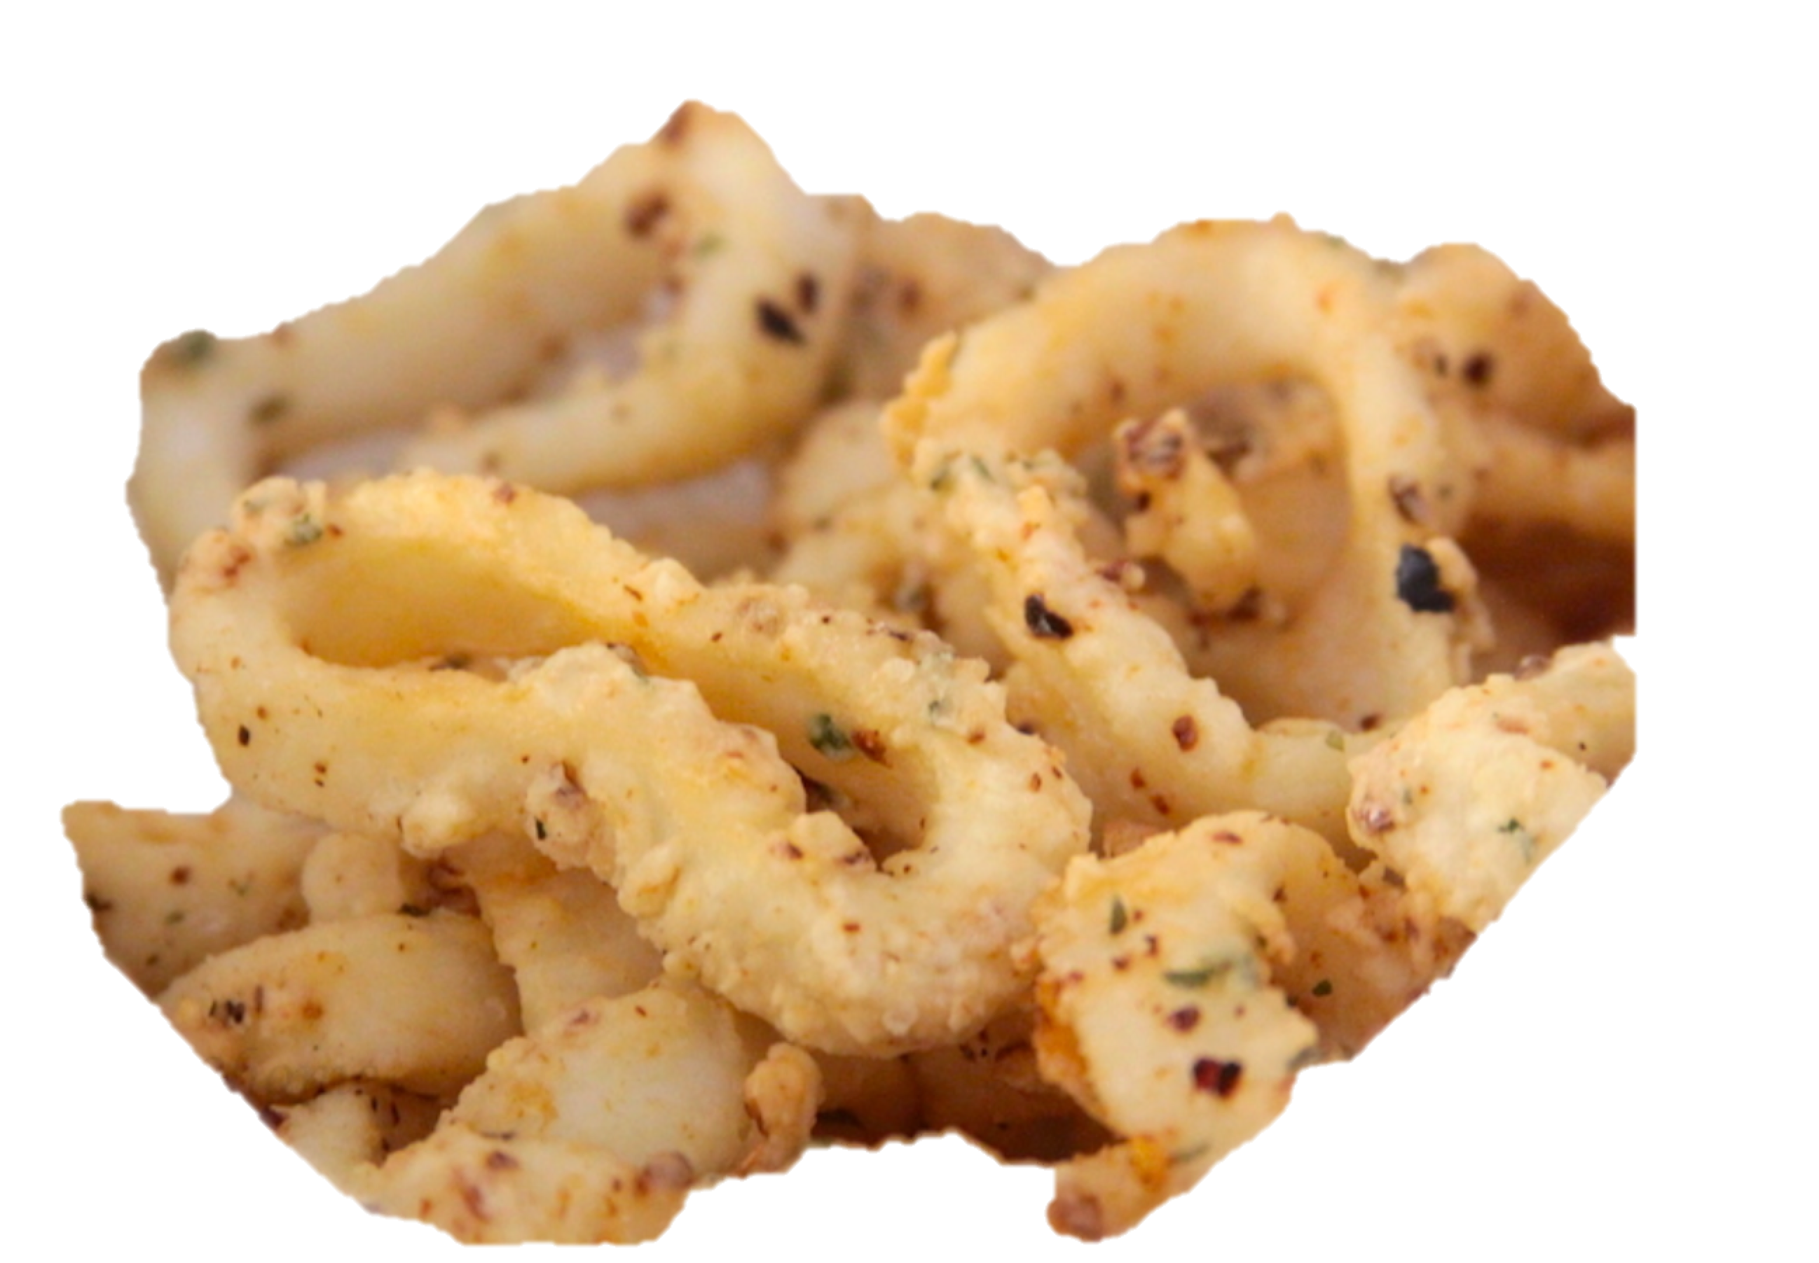
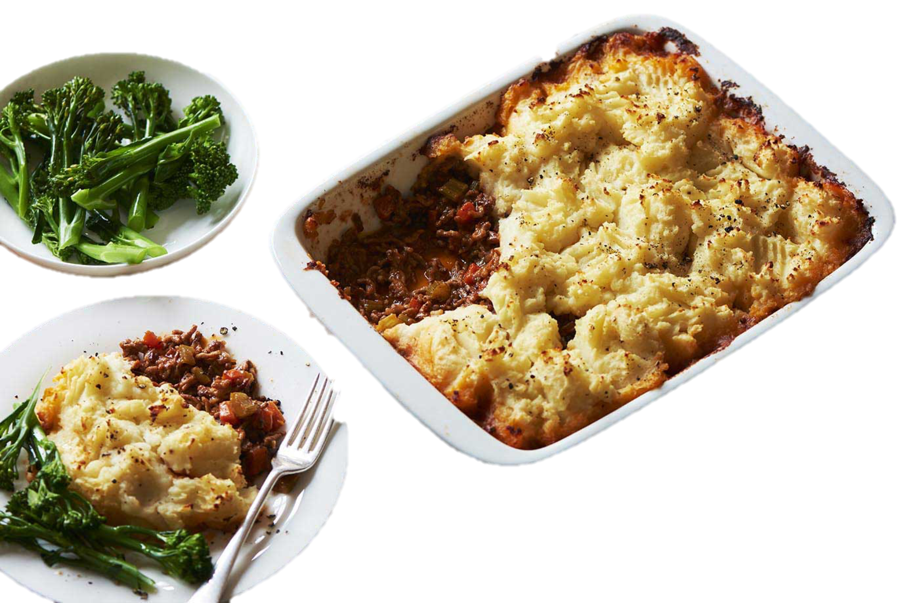
西餐

Slide 24
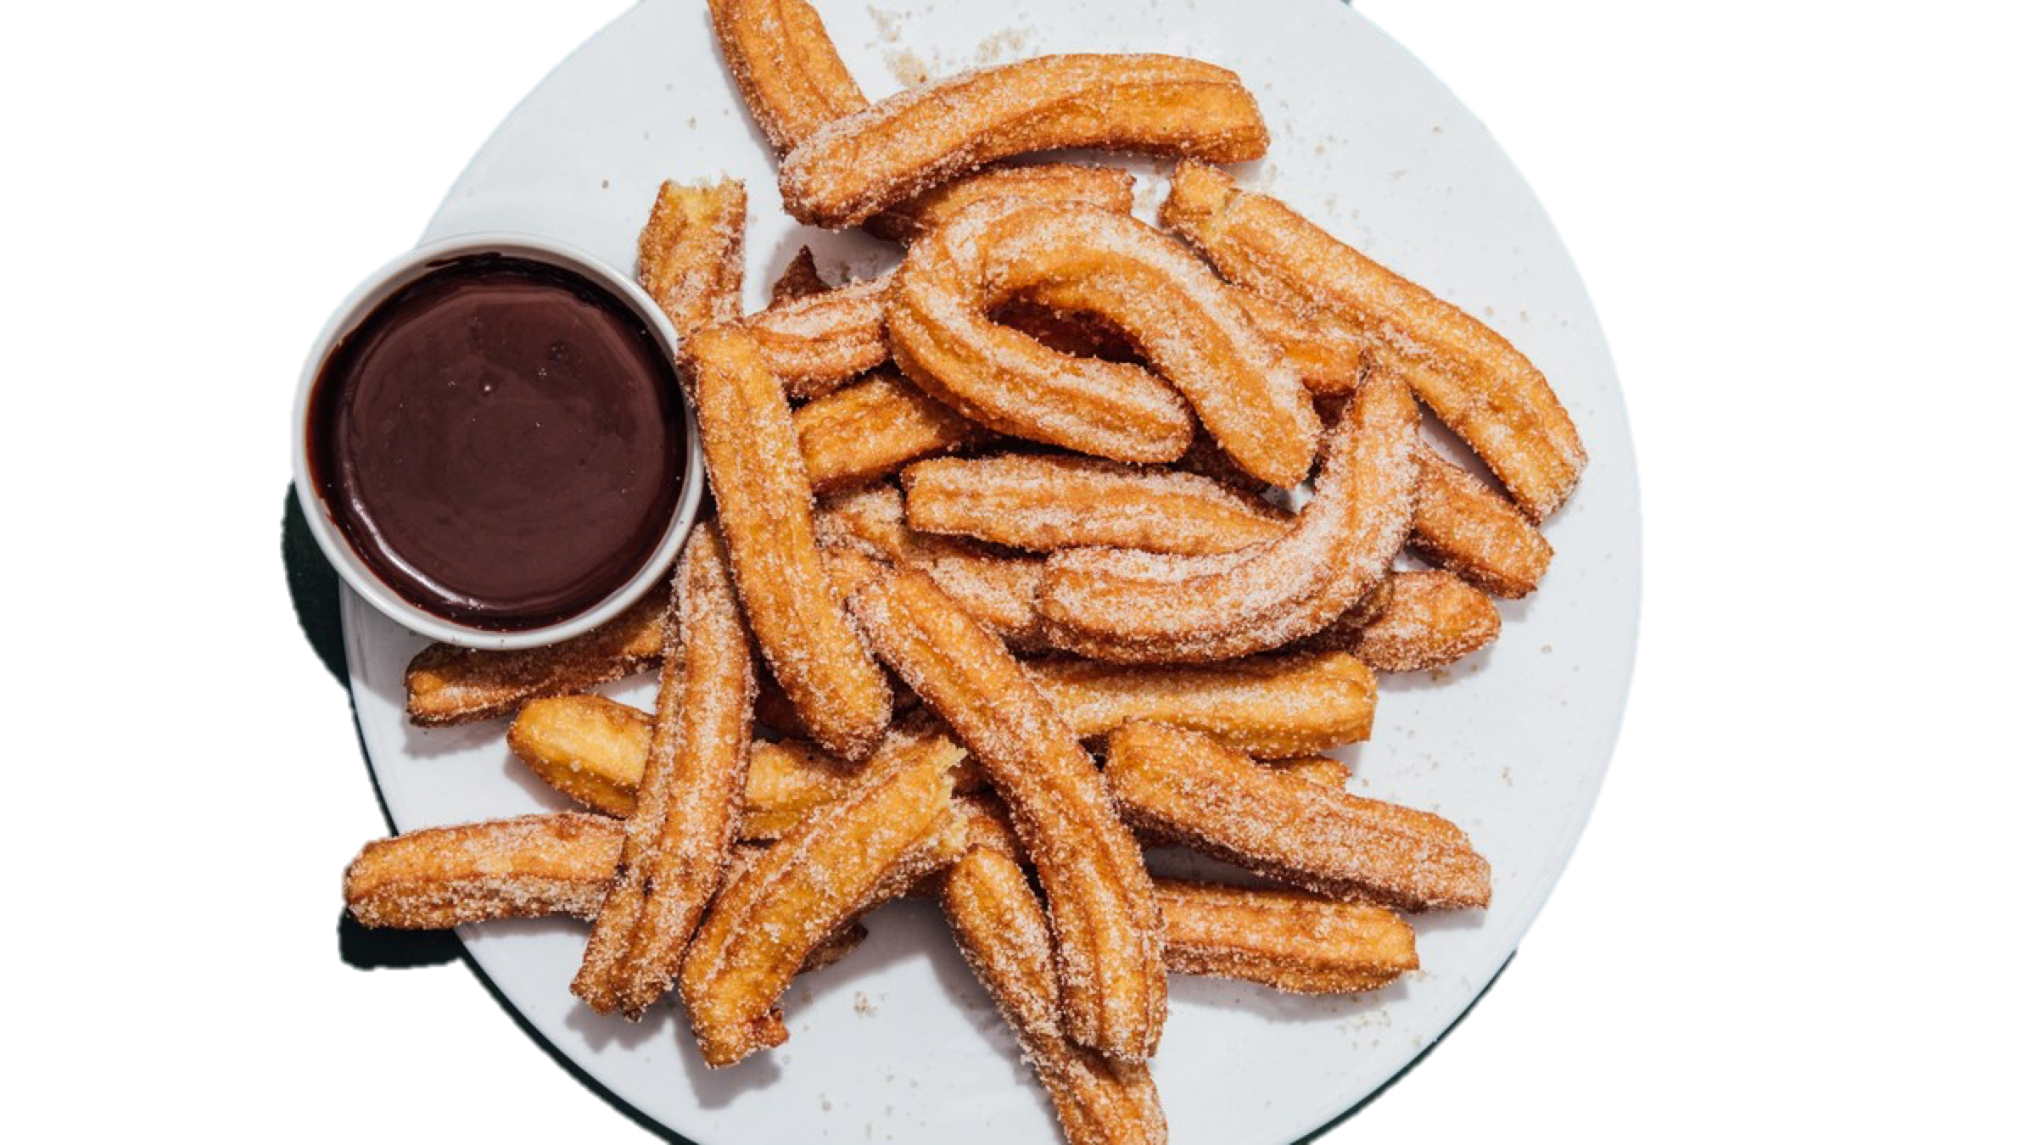
甜品

Slide 25

幸福礼袋
无限乐趣等着你
问答、奖品、和美食

